Slide 1
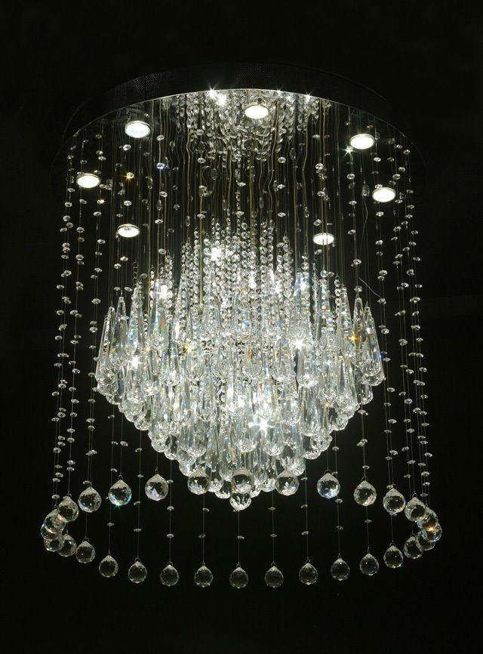
GLASSWARE
Submitted To:
Sakshi Bhardwaj
Stuti Bansal
Ritika Bansal
Kajol Gupta
Submitted to:
Mr. Mandeep Singh
(Technical Trainer)

Slide 2
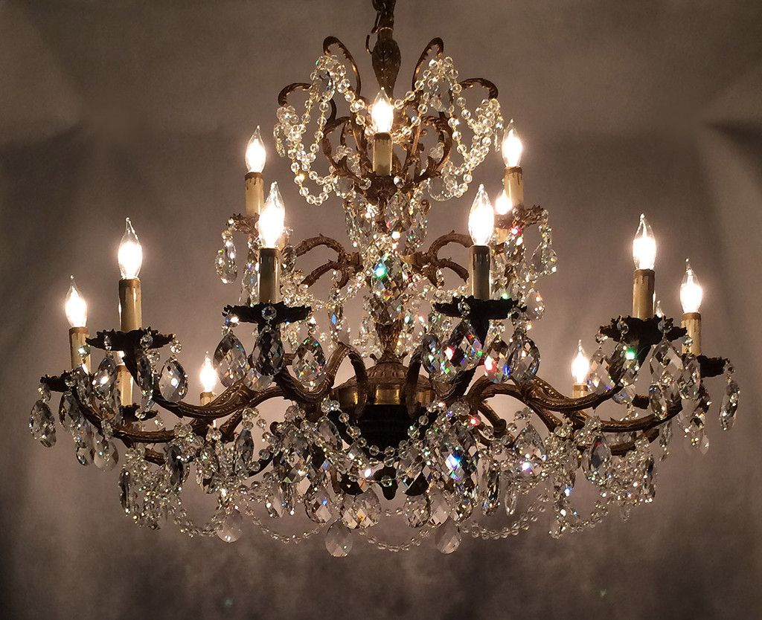


Introduction
The Project GLASSWARE aims to provide a responsive website which is an e-commerce website.
This website will contain information about glasswork like it will contain products like lightings , Chandeliers, Crockeries, Bangles and Antique Pieces.
This website will help the people to shop for various items of glassworks for various places like house, flats, apartments , business places, farmhouse ,mansions etc with the utmost facilities.

Slide 3
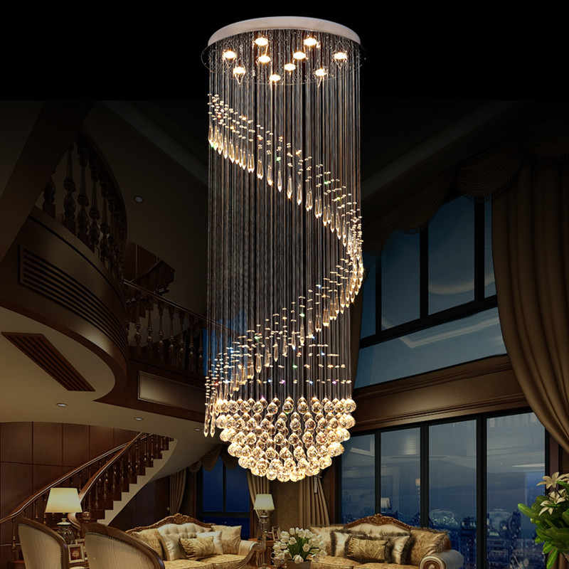
Objective
We are creating a real-time website to 'take a look of Glasswork’ effectively and effortlessly having great features involved. This site accommodates attractive interfaces that are easily accessible and understandable by the users. Altogether this website will include all items related to glasses and all the relevant details to it.

Slide 4
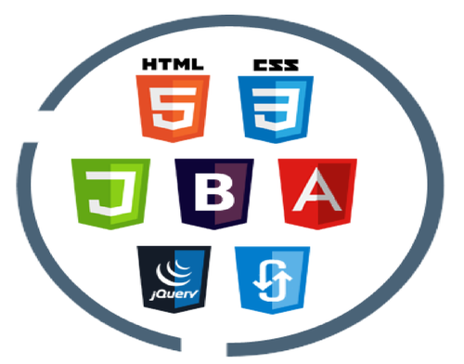
TECHNOLOGIES USED HTML CSS JAVASCRIPT MEDIA QUERY
This website is a Front-end designed website so all these technologies is used to design a website more interactive.

Slide 5

Html
HTML stands for Hyper Text Markup Language. Hypertext Markup Language is the standard markup language for documents designed to be displayed in a web browser.
It can be assisted by technologies such as Cascading Style Sheets and scripting languages such as JavaScript.
HTML describes the structure of a Web page.
HTML is a markup language which is used for creating attractive web pages with the help of styling, and which looks in a nice format on a web browser.

Slide 6

CSS(Cascading Style Sheet)
Cascading Style Sheets is a style sheet language used for describing the presentation of a document written in a markup language such as HTML.
CSS is the language for describing the presentation of Web pages, including colors, layout, and fonts.
CSS is fundamental to web design. Without it, websites would still be plain text on white backgrounds.

Slide 7

JavaScript
JavaScript is a language for programming; JQuery is a JavaScript library, a framework that helps you use JavaScript to simplify common web tasks.
JavaScript is a text-based programming language used both on the client-side and server-side that allows you to make web pages interactive.

Slide 8
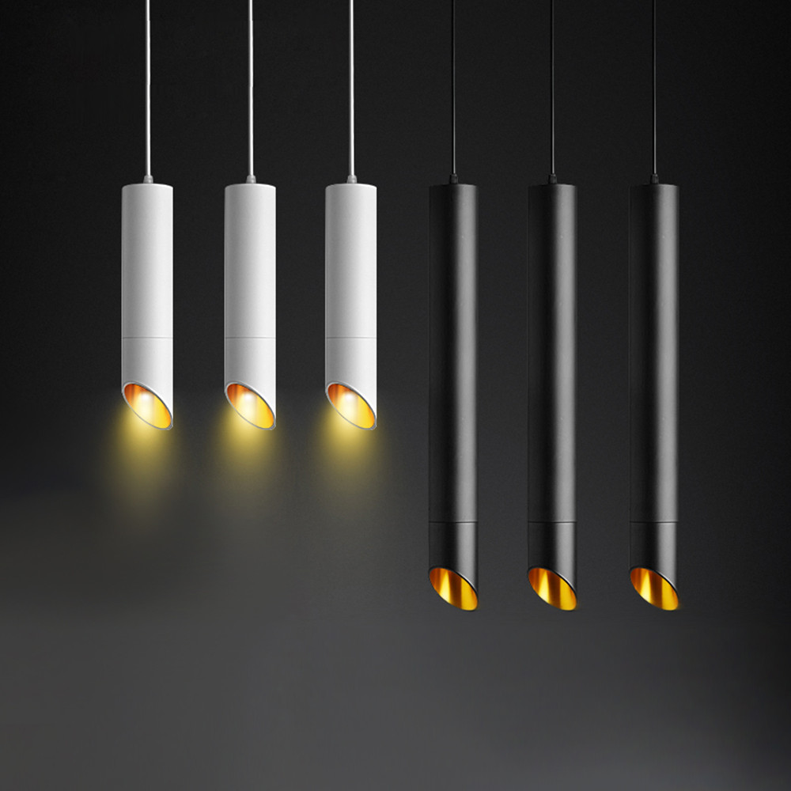
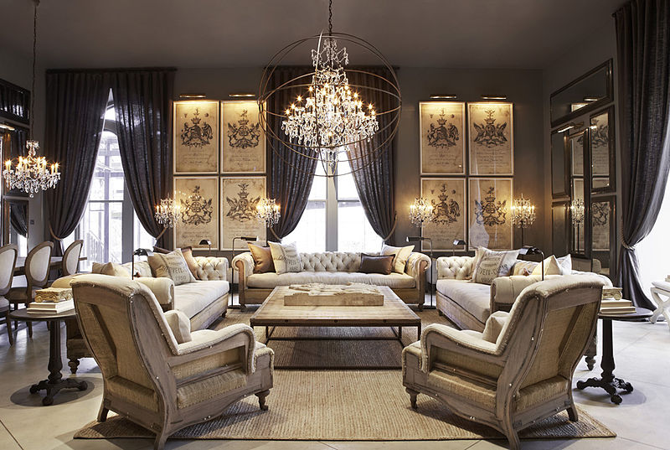
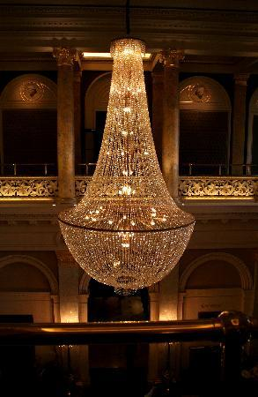
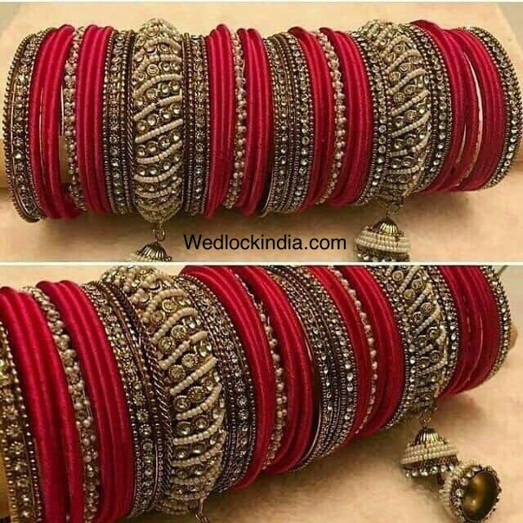
This is an E-Commerce Website and it contains various products related to Glass house like Chandelier, Crockeries, Bangles and Lightings. This is a Front-end Designed Website .It only Contains User Interface and no backend part.
Chandelier
Lamp Lights
Wall Lights
Hangings
Bangles
Crockery

Slide 9
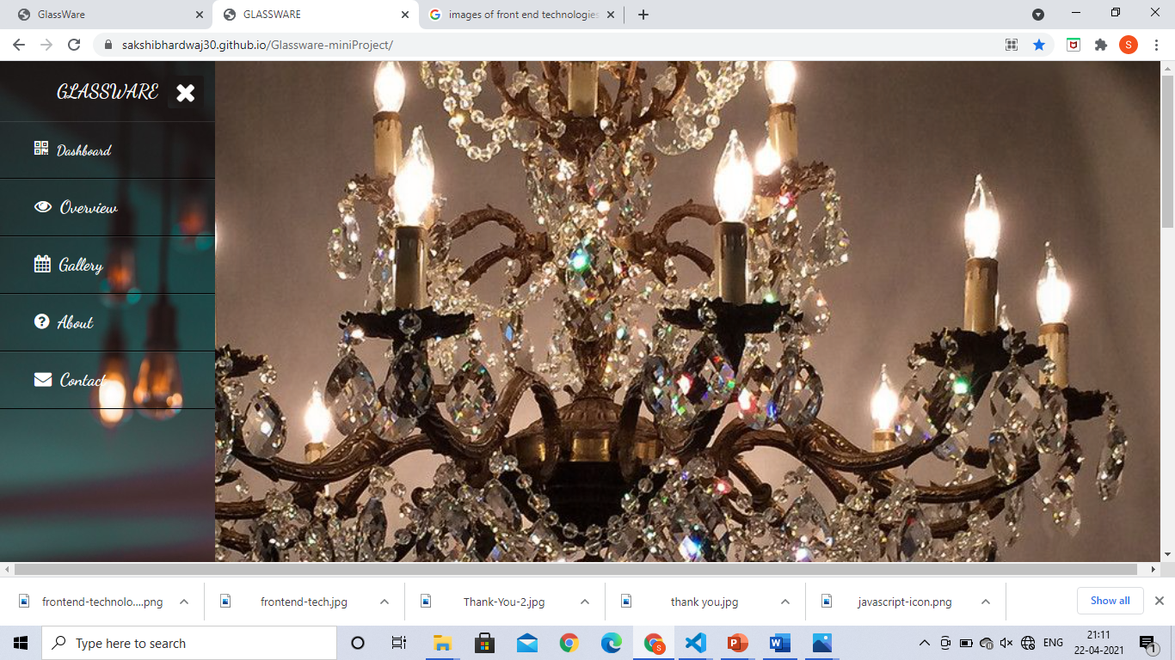
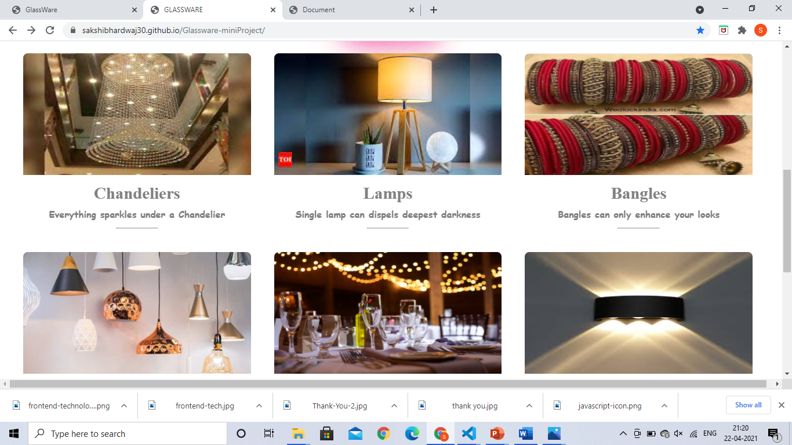
Overview of Project
9

Slide 10
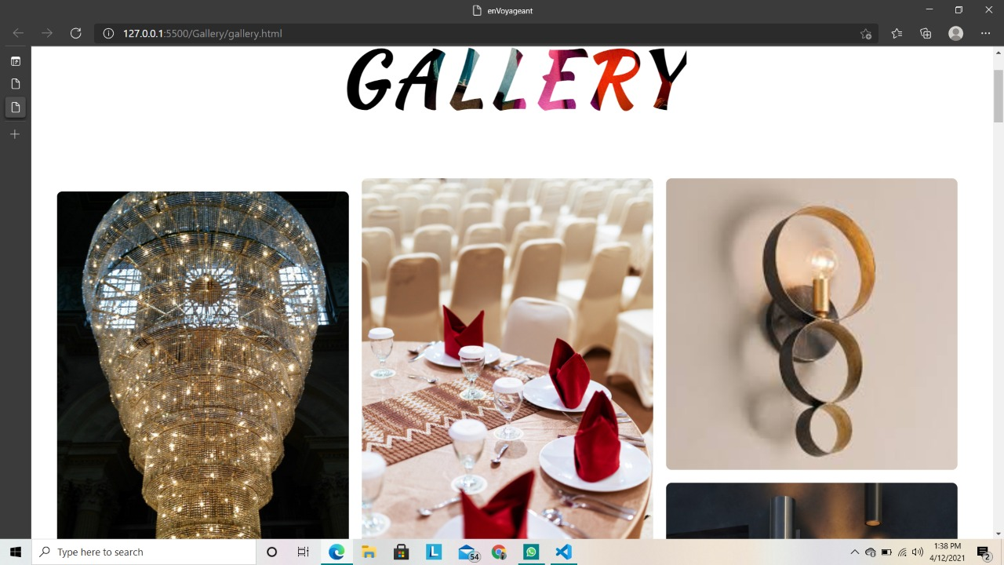
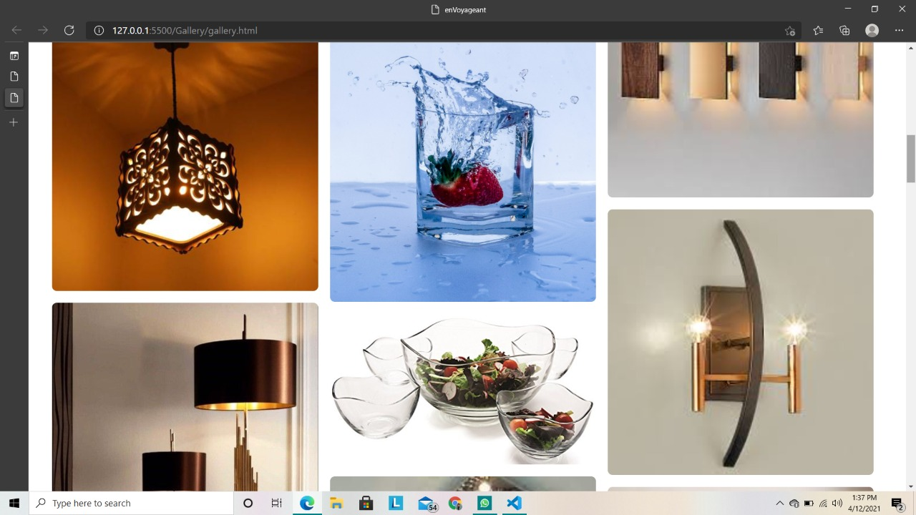
Gallery

Slide 11
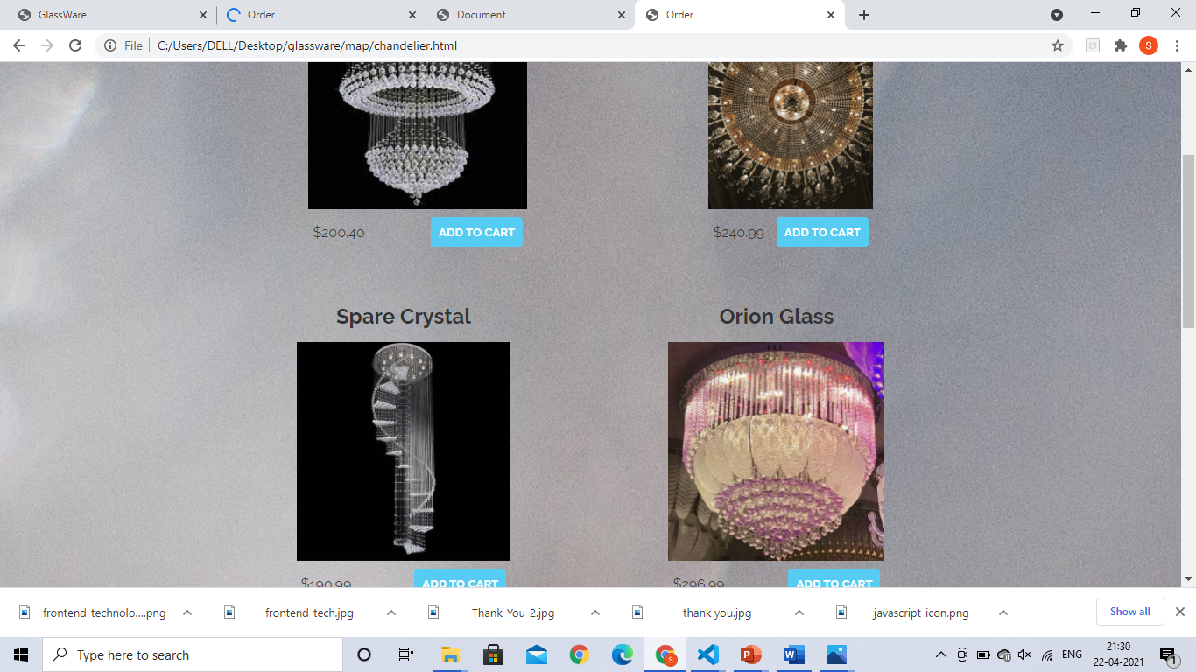
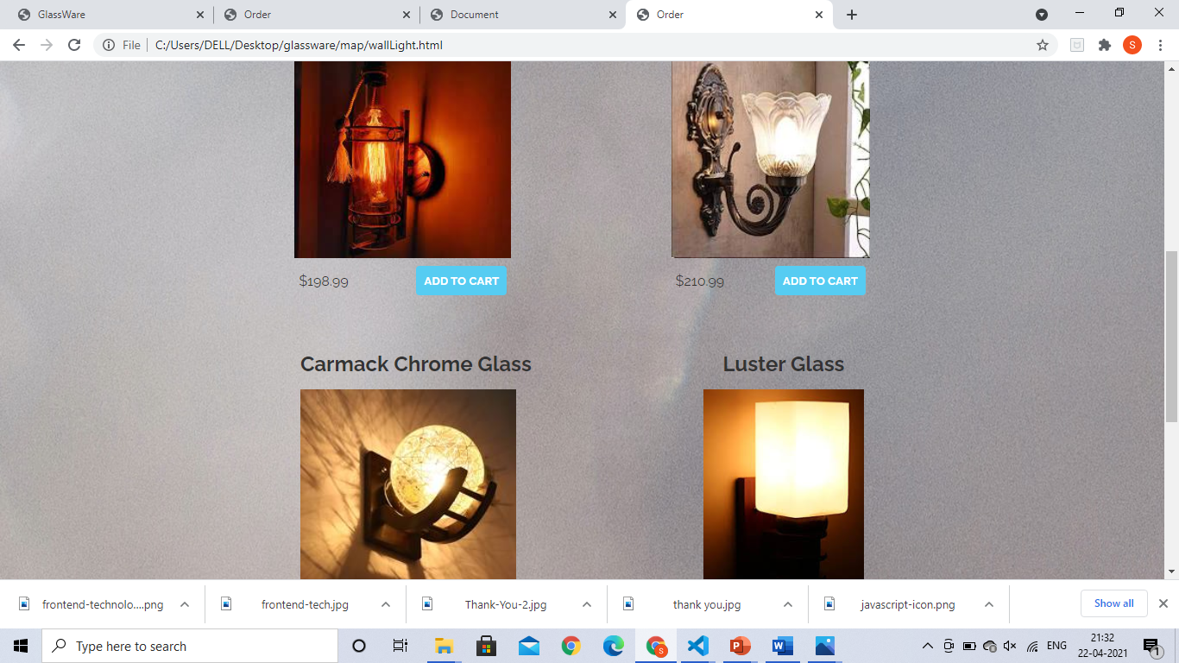
List Of items and their Prices

Slide 12
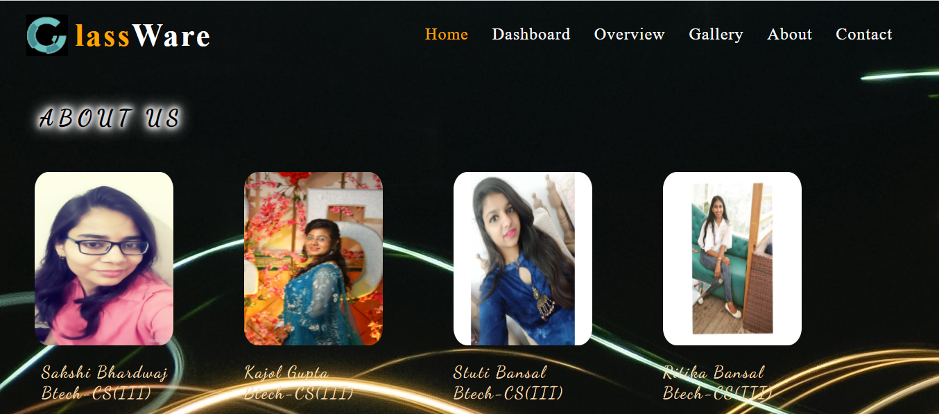
About Us

Slide 13
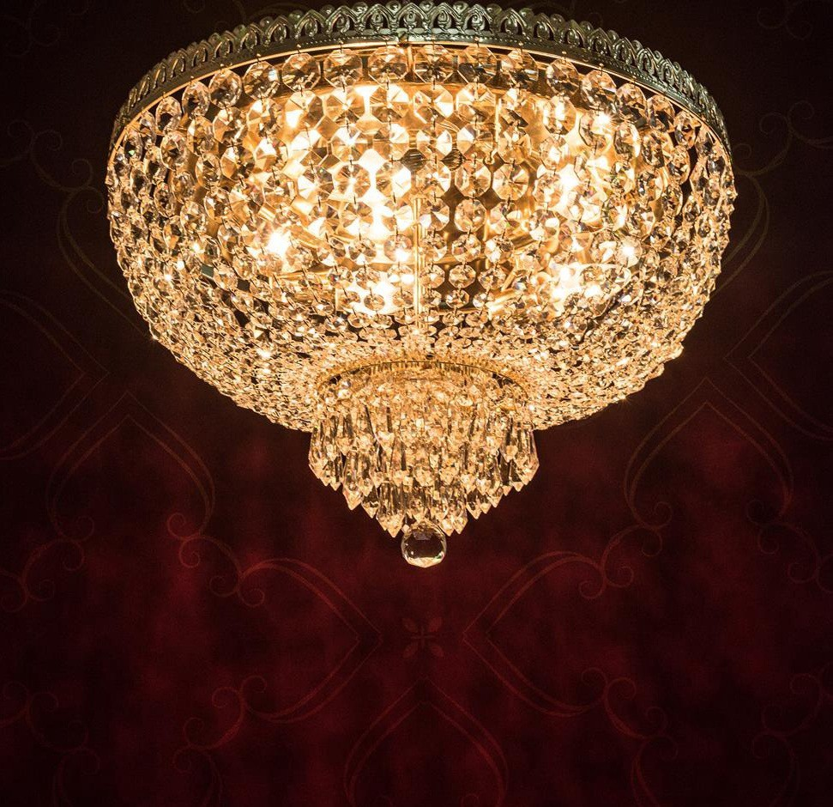
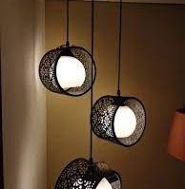
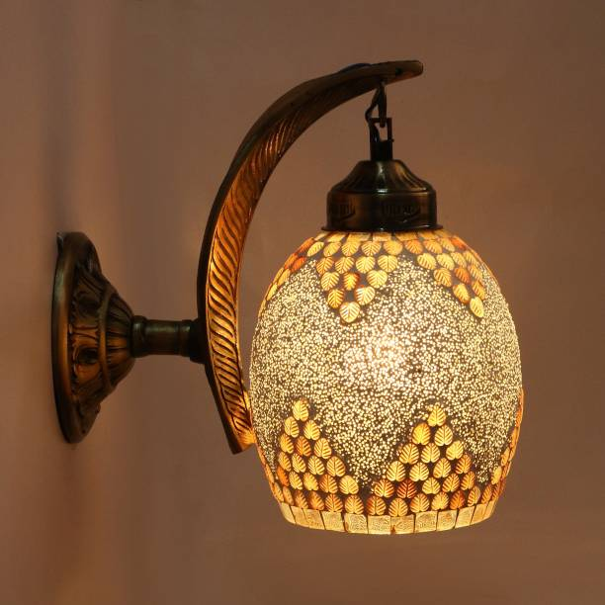
Summary
This site will intent to connect with the audience elegantly. Hence it is essential to have a strong and reliable front-end which can withhold the users on the site.
Our design objectives are:
A Responsive, Mobile-friendly Design
Clean, Easy-to-Use and User-friendly Search forms
Being Comprehensive and provide Complete Information
User-engaging and Attractive Interfaces

Slide 14

Thank You
Website Address:
https://sakshibhardwaj30.github.io/Glassware-miniProject/

